Slide 1
Market update
System Intelligence

Slide 2
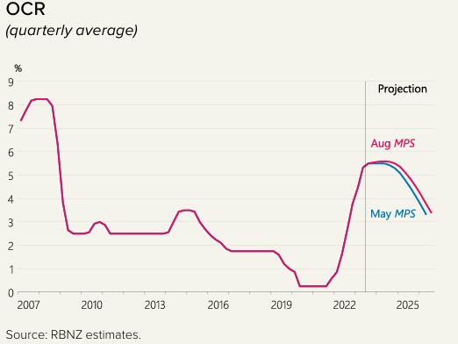
Economic outlook
Inflation rate is falling but still way too high, sticky domestic inflation
Net migration is at record high
OCR may stay higher for longer
Next indicators to look out for: wage inflation (Dec 2023) and CPI (Jan 2024)
Notes:
Migration could be showing some signs of stabilization (Monthly numbers show signs of dropping, covid pent-up demand being worked through)
International outlook is uncertain, wholesale rate is high, oil price may shoot up
Even with cut, it’s unlikely to go back to the record low level during Covid
Migration is supposed to contribute to softening wage growth. These indicators are key to RBNZ’s confidence that inflation is under control

Slide 3
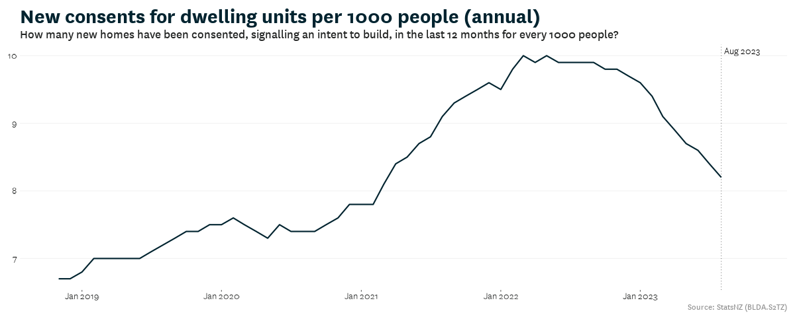
Construction sector
Consents continue to drop, and completion may have begun to slow
The lack of ‘pre-sales’ and challenging development economics
Kainga Ora activity remains strong
There’s risk that further downturn would lead to negative, long-term impact on the construction sector
Notes:
Consents – intention to build,
CCC – completion
Lack of presales: construction cost down but house price also down so there’s a wedge between cost of building new and purchasing existing. Need house price to go up so confidence returns
more projects being recently put on hold
which masks the decline in activity in several regions
Construction cost inflation slows down a lot but won’t provide much support
Consents are now near capacity level loss of capacity, take longer time to go up, bigger swings in the construction sector

Slide 4
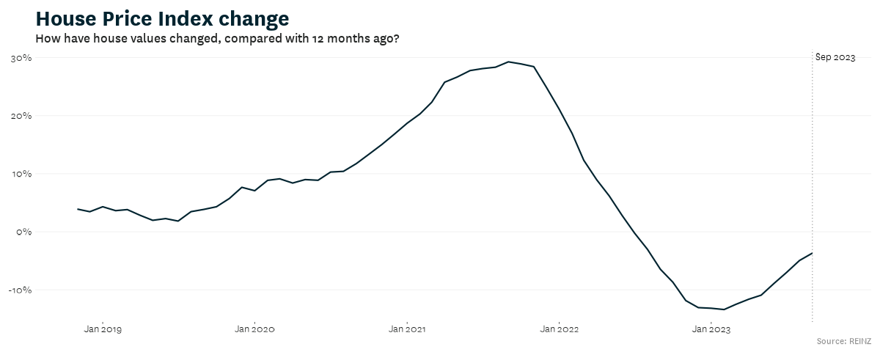
Property market
Some signs of recovery
FHBs remain active and investors maintain their market share
We do not expect a large surge due to high cost of ownership
Home insurance premiums increased, and insurers have signalled retreat from some areas
Notes:
FHB who can service their debt
(debt servicing, insurance, etc)
NIWE and flood-prone area. However, the speed and scale of this is still unknown at the moment

Slide 5
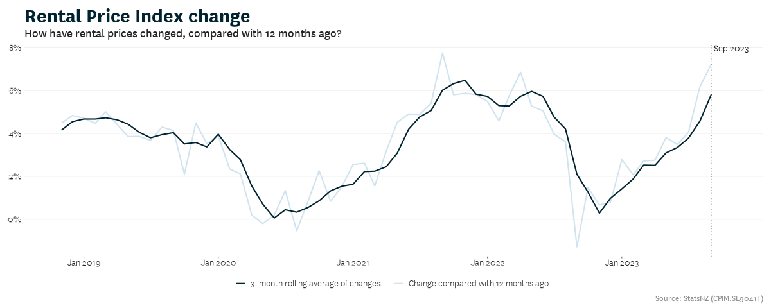
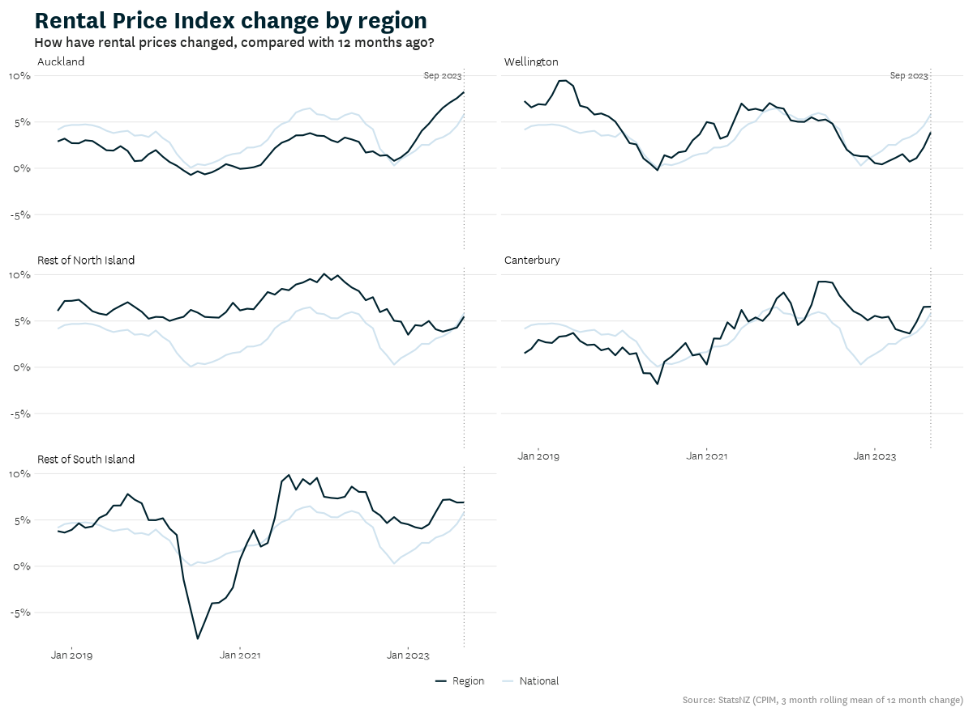
Rental market
High rental inflation, mainly driven by Auckland
High net migration is likely the key driver
Worsening affordability with high rents and subdued wage growth
Investors’ confidence may return with potential tax policy changes and high yield
Notes:
Removal of interest deductibility

Slide 6

What drives rents in New Zealand
Joint research paper with Treasury and RBNZ
October 2023

Slide 7
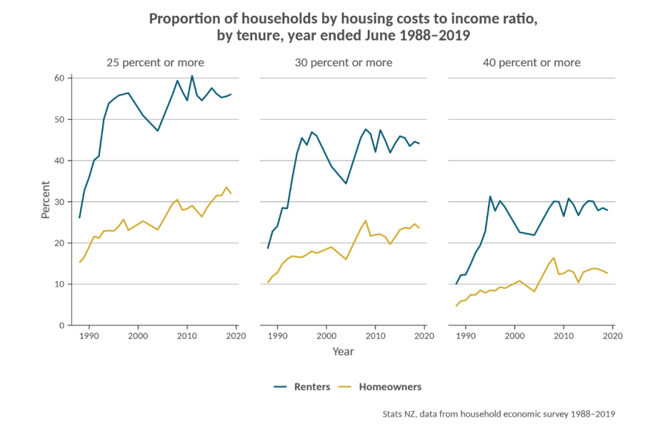
Why should we care about rents?
More people are renting (privately)
Renters are more vulnerable to large movements in housing costs
Rents is a better signal of the balance of supply and demand for dwellings than house prices
Forecasting rents can also improve the accuracy of house price forecasts
Notes:
Especially since the early 1990s. From Census 2018, out of all households that rent, 4 out of 5 rent privately
As they typically pay a larger proportion of their incomes on housing costs than owner occupiers and so
Rent prices reflect the “true” price/cost of housing services consumption
Rent prices do not include expectation of future gains like house prices do
Forecasting rents better: They are one of the factors that influence house prices. Excluding debt servicing/maintaining cost and expected capital gains, house prices should equal to the net present value of rents. Treasury are now incorporating the finding into their rent and subsequently house prices forecast (system leadership role)

Slide 8
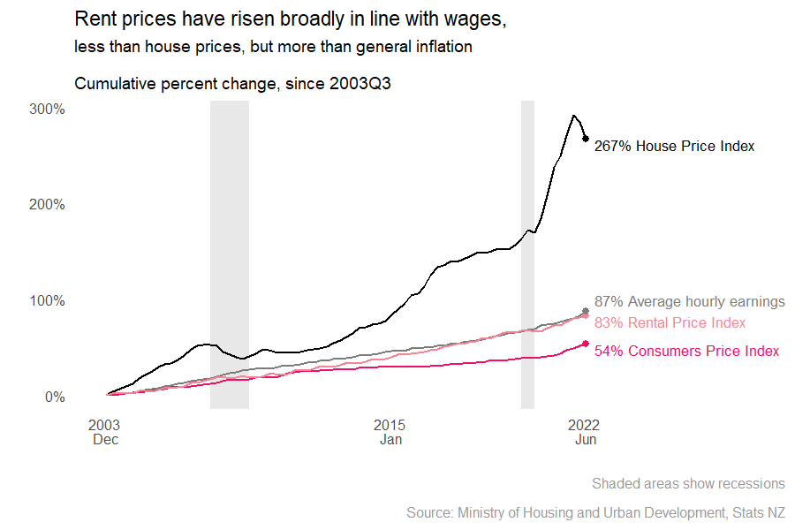
.
The framework helps us to understand how land and housing markets operate.
The recent HTWG’s assessment of the housing system concludes that the land market in NZ is restricted to some degree
Underpinning this is the assumption that interest rates impact house price but not rents
We want to test this hypothesis explicitly

Slide 9
Potential factors
Wages
Physical supply and demand of dwellings (measured by people per dwellings)
Mortgage (interest) rate
General inflation
Unemployment rate/job security
House price
Notes:
Wage: Renters ability to pay
Supply/demand: Availability of rental properties
Mortgage rate: first home buyers may delay buying due to rising mortgage unaffordability, increasing demand for rental property. Higher financing cost reduces supply response. As supply increase, yield decrease so banks are less likely to lend to develop
Unemployment: Job security and household formation. Better job security can encourage people to form new and smaller households, which in turn, increases the demand for rental properties. For example, young adults may be more inclined to leave the family home when unemployment is low. Secondly, a strong labour market and positive economic outlook would ensure tenants’ current and future ability to pay, allowing landlords to raise rents
Any other impact that are not included in wages
House price: unobserved region-specific factors act on the housing market as a whole, rather than just the rental market. in a falling market time to sell would be expected to increase which may lead to an increase in the rental stock, and therefore downward pressure on prices.

Slide 10
Key findings
Wage inflation and relative supply and demand of dwellings (measured by people per dwelling) are the two key drivers of rent inflation for new tenancies at the national level.
Increasing mortgage rates increase rents and increasing unemployment decreases rents but the impacts are relatively weak compared with wages and dwellings supply and demand
Wages and relative supply demand are also key drivers of rents at the regional level, although unobserved region-specific factors can dampen or magnify these effects in particular regions.

Slide 11
Key findings in numbers
All else equal, a 1 per cent increase in nominal wages leads directly to 1 per cent increase in new tenancy rents
A 1 percent increase in people per dwelling leads to a 1.5 percent increase in rents at the national level
Notes:
5 million people and 2 million dwellings
(50k more people or 20k less dwellings),

Slide 12
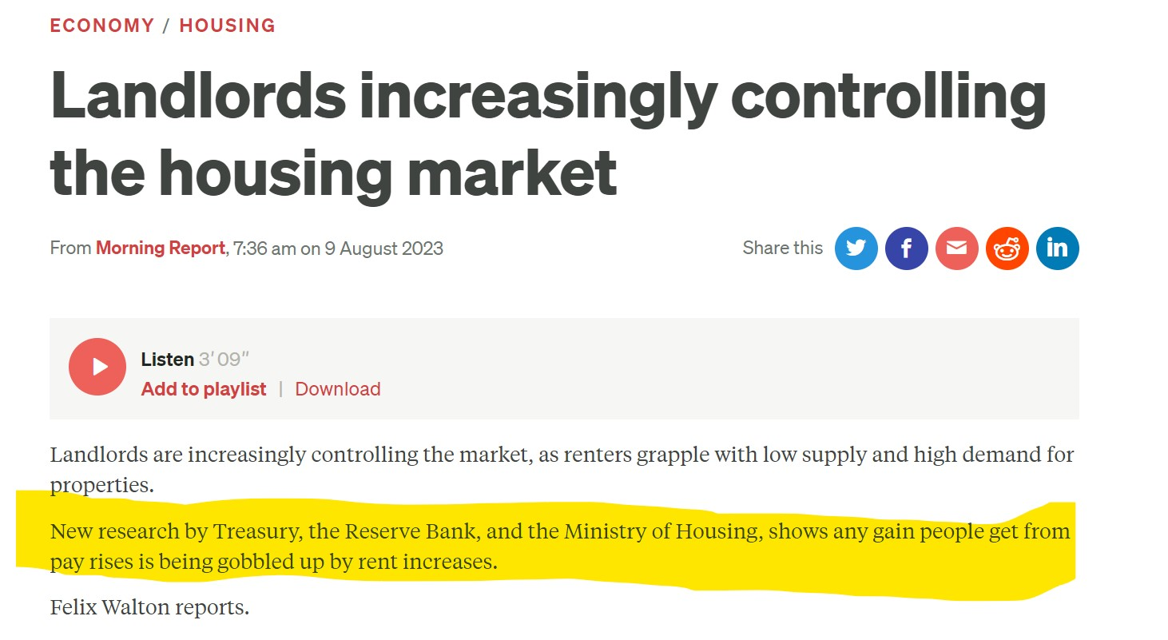
Media coverage
Renters only pay a proportion of their income on rents
The 1 to 1 relationship between wage and rents does not mean that all the dollar that tenants gain from wage go straight into rents
Notes:
Very happy that the paper sparked discussion in the media, mainly between landlords and tenants.
Mainly good, however, some implications are misleading, so I’ll take the final minutes to
Renters only pay a proportion of their income on rents
The 1 to 1 relationship between wage and rents does not mean that all the dollar that tenants gain from wage go straight into rents

Slide 13
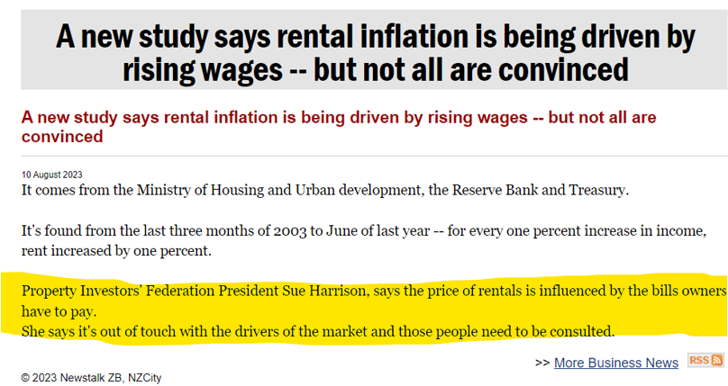
Media coverage
Historically mortgage costs have not always moved with rents
Notes:
No, costs do matter, just not as strong and consistent as wages and relative supply and demand of dwellings
Historically costs (mortgage, rates, insurance) have not always moved with rents, hence the relatively small impact found in the report

Slide 14
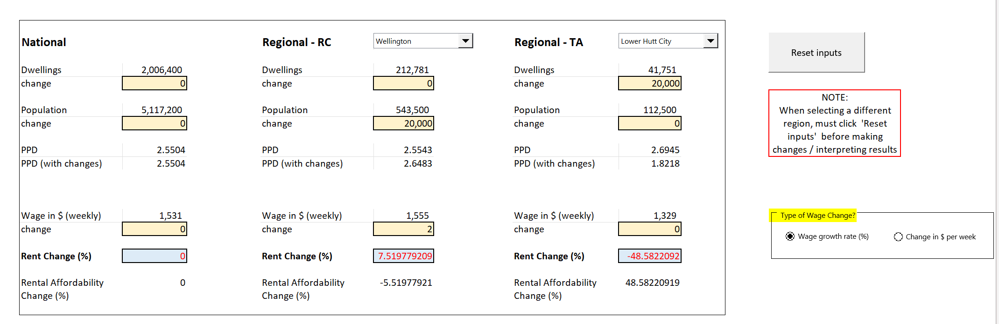
Rent drivers tool
Notes:
We have developed a simple tool to put the findings of this report into action,
If you have a policy/change that might impact population/dwellings/wage, you can input these into the tool and see how much rents would change if (1) all else equal, (2) the past is a good representation of the future

